Slide 1
Can’t Trust These Logs
José Alberto Martinez
@bluejosem

Slide 2
Assumptions
Incorrect ones can be made by both attackers and defenders. It’s our goal to test some of these, and with a little creativity break them.
Only so much time and effort available to developers.
Usability vs Security. What makes business function.
Assumptions on what’s safe, accessible. Intranet vs Internet.
Development Environment VS Production. Data on both.
Malicious insiders, attackers within the network.
Previously tested, no more vulns or low hanging fruit?
Information Disclosure: it’s just a low…
Limited functionality…where’s the danger (Case Study)

Slide 3
Intranet VS Internet
Don’t only test internet facing apps or assets on the internet.
Case study: directory enumeration reveals a large amount of logging endpoints with different degrees of information. Not locked behind authentication…
Per dev set for development purposes…but info mirrored production.
Valid session tokens could be used on another discovered endpoint to create new valid session tokens…

Slide 4
Intranet VS Internet
Testing internet facing app
Found CMS when did directory enumeration. But only visible on intranet. Not available public internet.
Did further enumeration.
Found APP.com/logs/apiservice/RestIE_2020_20_20.log
Found production authentication endpoint, JWT token, app and username for an admin, access token value, token type, technology in use, when that token expired, and the endpoint used for OAUTH authentication.
Googled technology, found how to use data for fresh tokens. Thank you https://oracle-base.com/articles/misc/oracle-rest-data-services-ords-authentication. You’re the best.
Verbose technology data, other juicy information. Way more than I had time to use or research. Including SQL statements.

Slide 5
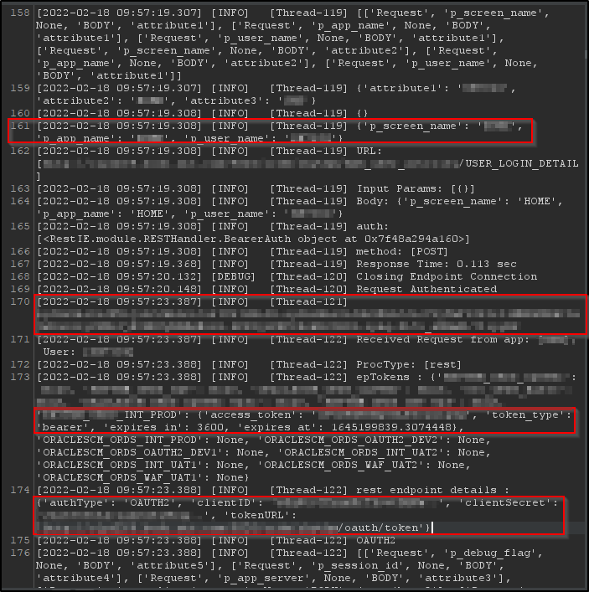
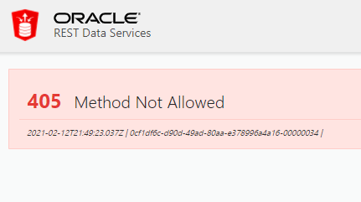
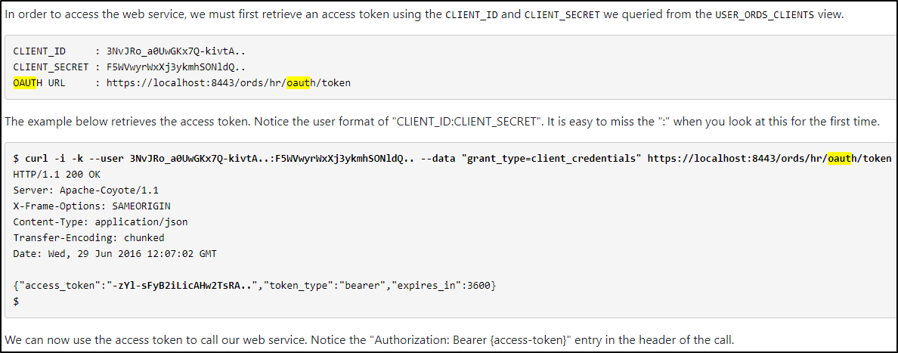
Intranet VS Internet

Slide 6
Intranet VS Internet
Logs – could potentially reveal malicious activity. But unsecured, or via malicious insider could log information leading to application takeover, privilege escalation.
To avoid:
Session tokens in URLs or headers visible in logs
Passwords visible in plain text
Password or sensitive values being base 64 encoded, easily decipherable or predictable, values visible in logs. (think base 64 Basic Auth headers)
Etc.

Slide 7
Limited Functionality
Case study: public site only serving documents, mostly static content otherwise
Someone found vulnerability via public bug bounty same day I started my test. This had only lows last time we tested this…💀.
Couldn’t find anything…but then triggered an error
Error sends email to admin….hmm.
Escalate to critical: email anyone as admin from this large company.
Error functionality instead of helping app dev, helped set up our attack. Email bomb ahead!

Slide 8
Limited Functionality
APP.com/Stuff/errorsubmit.cfm
An error has occurred. Please complete the following information, blah blah blah:
ID:
Email:
Phone:
[Next Button Here]
Found request this triggered, emailing an admin. Found could use to email anyone as admin. Turn into email bomb, use for phishing, bypassing spam filters as valid company email:
POST /Things/searchSite.cfm HTTP/1.1
Diagnostics=arbitraryt+text&DateTime=URL Encoded Time Value&Browser=values&RemoteAddress=IP&blahblah=stuff&QueryString=[HTML injection and arbitrary URL possible here]&Mailto=VictimEmail@mail.com
Could then automate this in Burp Intruder

Slide 9
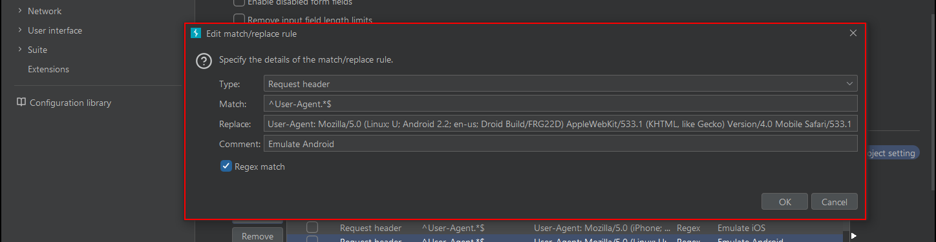
Information Disclosure: Path To High or Crit
Finding high privileged or developer username IDs, potentially using them to emulate them and their privileges.
Replacing my user identifier with theirs in request…
Match and replace in Burp in requests or responses.

Slide 10
GUI’s locked down. But the API…
Looking for user identifiers and indicators of permissions. Use information from recon and previous observations.
If any sort of user directory, or application documentation…great.
Predictability in user values and privileges?
Admin Y/N, 0 vs 1, userid=#, etc.
Rate limiting preventing brute forcing through options, fuzzing?
Source code reveals permission names…

Slide 11
GUI’s locked down. But the API…
Request:
OPTIONS /api/APP/user?AppSpecificIDNumber=0001
Response:
HTTP/1.1 200 OK
First Name: Person
Last Name: Last
Roles: [APP, App2, Admin]
Request:
OPTIONS /api/stuff/getApp?owner_id=Name&admin=true
Now when we look at the application GUI, we see many more options and menus load. This is a good sign that privilege escalation has been achieved or can be built up more.
No Rate Limiting:
For the above, I could cycle through and find valid users values for the below 2 apis:
OPTIONS /api/APP/user?AppSpecificIDNumber=0001
GET /api/APP/getUsernamefromDirectory?ID=Name
Find valid users, check for admins and higher permissions at our leisure. We can make ourselves owners of arbitrary compliance items…

Slide 12
GUI’s locked down. But the API…
Don’t forget you can intercept and modify response values. If no client side check, and response sets privileges…
Response from APP.com/stuff/api_services/report/repairDisabledFlag
HTTP/1.1 200
“testmode”:“Y”
“repairDisabled”:“Y”
“testModeUpdateDisabled”:“N”
“1RepairDisabled”:“N”
“2RepairDisabled”:“N”
“environment”:“PROD”

Slide 13
User impersonation…now what
Create alternate higher privileged accounts for persistence
Keep switching between users to try and make malicious activity quieter
As attacker, delete the logs if possible, removing traces
Escalate privileges to areas not logged
Logged, but so what
No one’s checking the logs, or they’re not triggering alarms

Slide 14

Overly Verbose Error
Stack traces leading to privilege escalation
Open directories with tons of credentials in clear text in disclosed source code. [Case Study]
APP.com/dynamic/dbtoools/get_domain
APP.com/dynamic/dbtoools/get_request
APP.com/dynamic/dbtoools/get_userID
Verbose Django and Python errors, by playing around with and reading data, manually fuzzing, led to open directories
These had source code plaintext LDAP credentials, all sorts of app creds giving us full control.

Slide 15
Overly Verbose Error
APP.com/app_frontend/domain/tmp.txt
APP.com/app_frontend/root/bootstrap-table/
APP.com/app_frontend/python_ldap_api/var/ldap.log
APP.com/app_frontend/python_ldap_api//www/cgi-bin/revalidation.py
APP.com/app_frontend/python_ldap_api/etc/logger.conf
APP.com/app_frontend/python_ldap_api/etc/ldap.conf

Slide 16
Overly Verbose Error
APP.com/app_frontend/python_ldap_api/etc/ldap.conf
[main]
logger_config_file: /var/www/html/app_frontend/python_ldap_api/etc/logger.conf
host: HostName
auto_user: User
auto_pass: Pass
read_user: Read_User
read_pass: Read_pass
email: person@person.com
[Directory]
host: somesite.directory.com

Slide 17
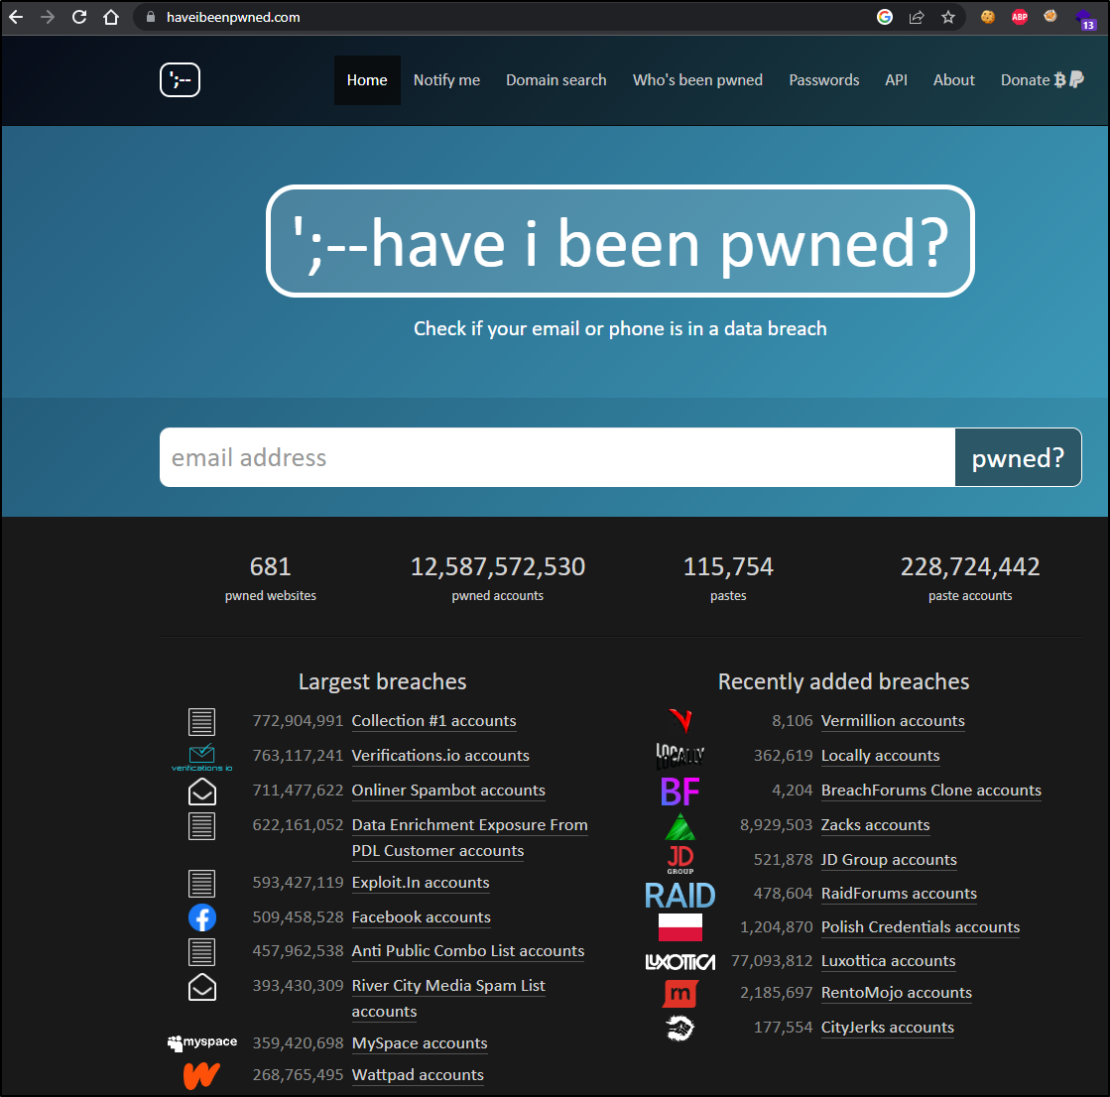
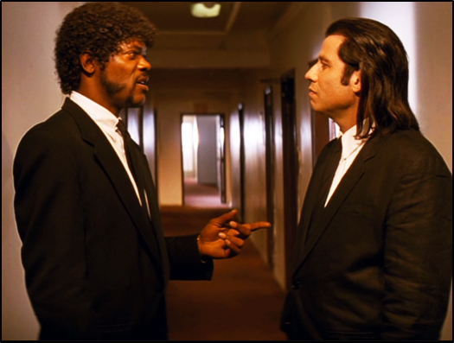
Further Research, Building Upon Known Knowns
Predictable user names, email structure
Previous user dumps, LinkedIn scraping
Google dorks
https://haveibeenpwned.com/

Slide 18
Cookie Stripping
Inconsistent authorization checks in app
Either API feeding GUI, or certain actions themselves don’t require cookies
Unnoticed in logs, as by default might have cookies
However, erase all cookies, and the request goes through???
Non auth check ➔ anonymous activity achieved

Slide 19
Bringing It Back To Logs
If you’re just checking for user identifiers, and attacker has impersonated another user…
Integrity implications
Even if irrelevant user values, it can allow us to further understand application, technology in use, format of expected values
Any privilege escalation or incident might lead us to not treat everything we see in them as absolute
We might not trust these logs, or at least, not any one thing in them by itself

Slide 20
What can be done
Defense in depth
If a “Log4j” were to happen again, would you know?
Have your detections for indicators of compromise go beyond basic user identifiers. Search for unusual behaviors.
Unusual times, geolocation, headers, etc

Slide 21
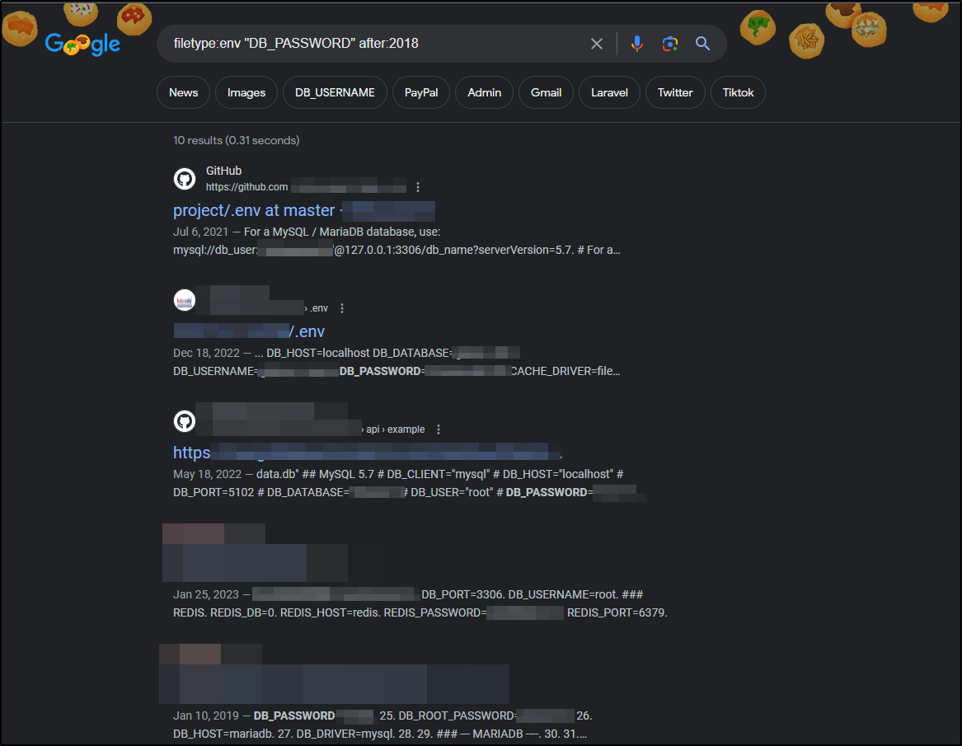
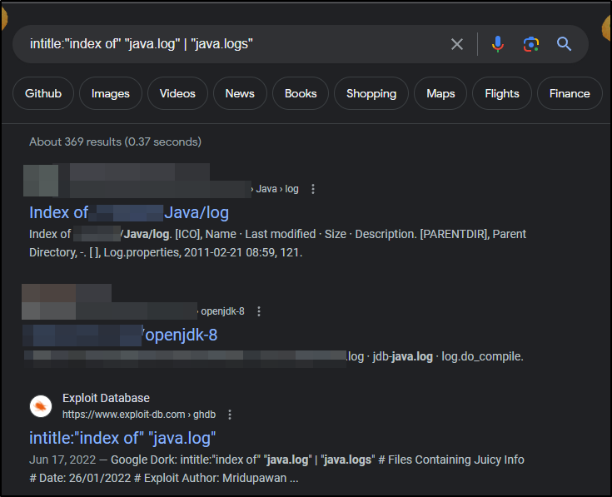
DIY (Ethically):Google Dorks
https://www.hackthebox.com/blog/What-Is-Google-Dorking
https://null-byte.wonderhowto.com/how-to/find-passwords-exposed-log-files-with-google-dorks-0198557/
https://www.exploit-db.com/google-hacking-database

Slide 22

Questions?
Let me know on Discord, or hit me up on Twitter (while it exists) @bluejosem
Will be taking questions in the lounge area, will also be around Con

